Slide 1




Gene Expression and Genetic Variants
Data Analysis And Visualization R package
EXPviz
ExpVar
SNPviz
Team Hiba Ben Aribi
Imraan Dixon
Najla Abassi
Olaitan Awe
CNVviz

Slide 2
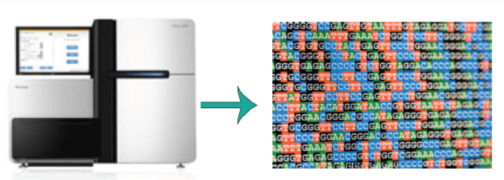
Background
Gene expression
Genetic Variantion
RNA sequencing
Fastq files

Slide 3
Solution
EXPviz
Expression Data Visualization
Preprocession
Gene Counting
ExpVar
SNPviz
SNP Data Visualization
Variants calling
=
SNPs
Indels
CNVs
CNVviz
CNV Data Visualization

Slide 4
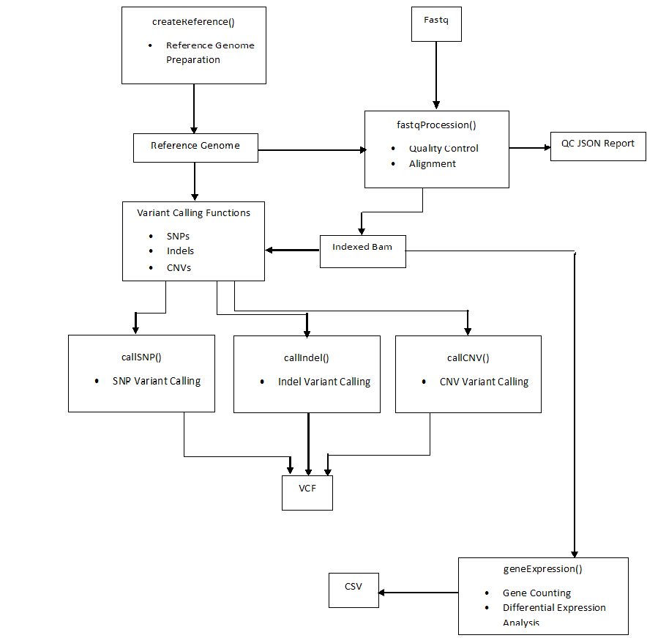
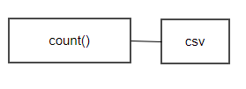
Data Analysis Workflow

Slide 5
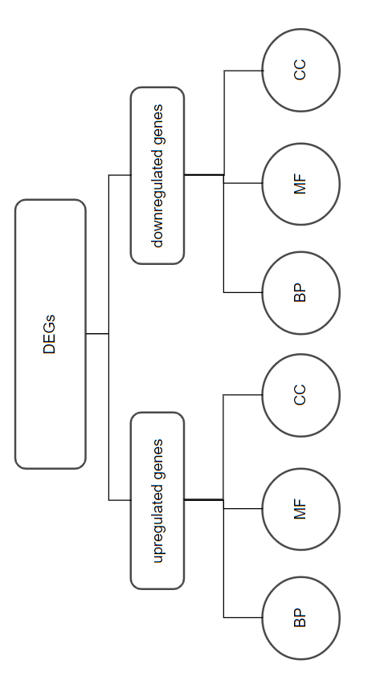
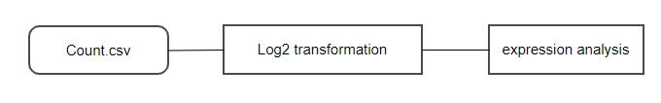
Workflow
EXPviz
Normalization
KEGG

Slide 6
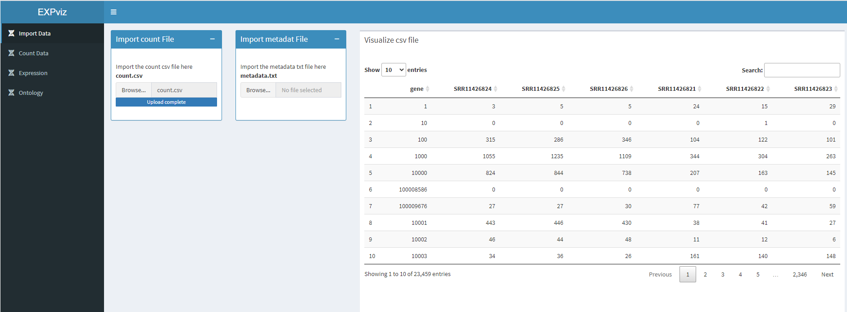

Slide 7
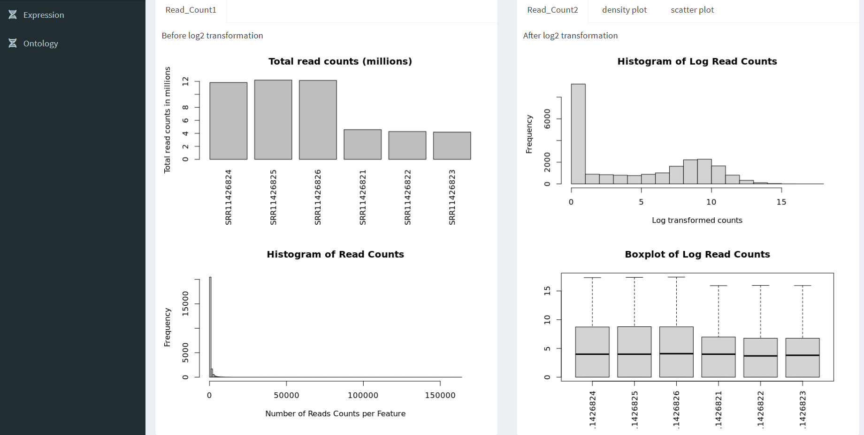
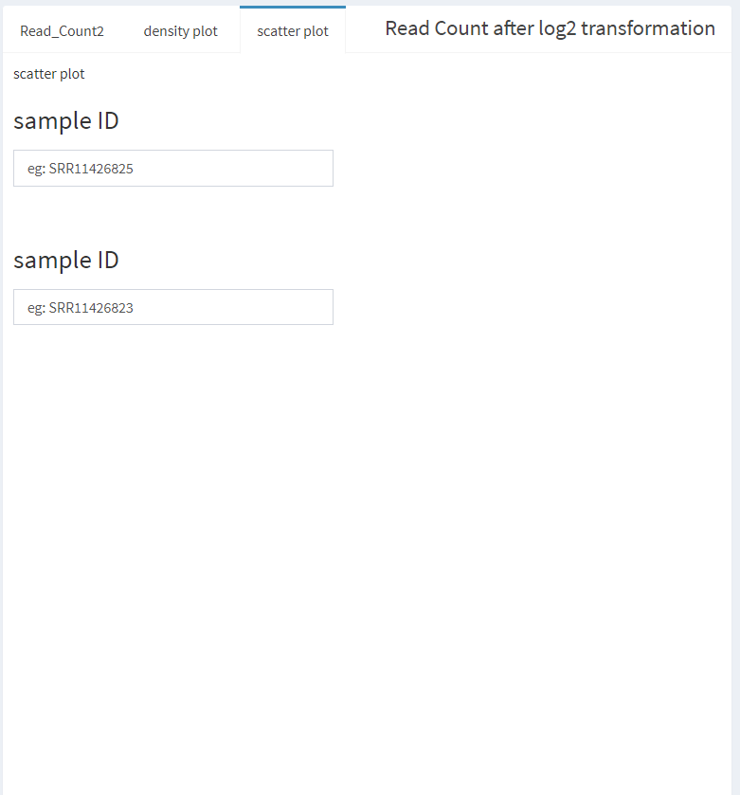
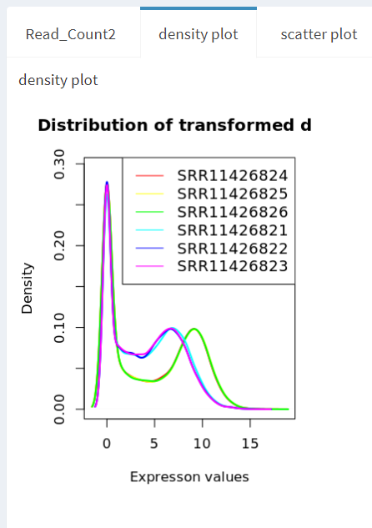
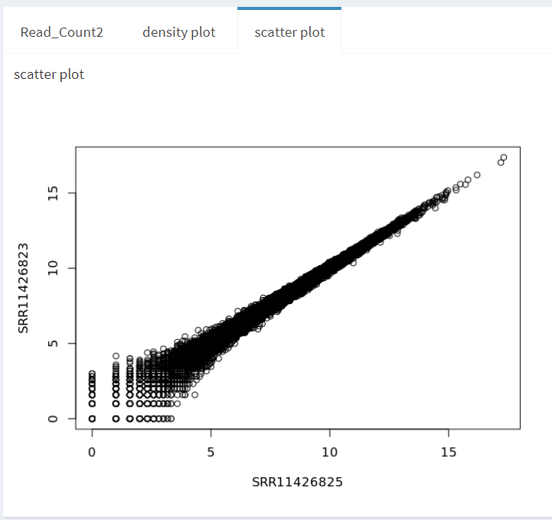

Slide 8
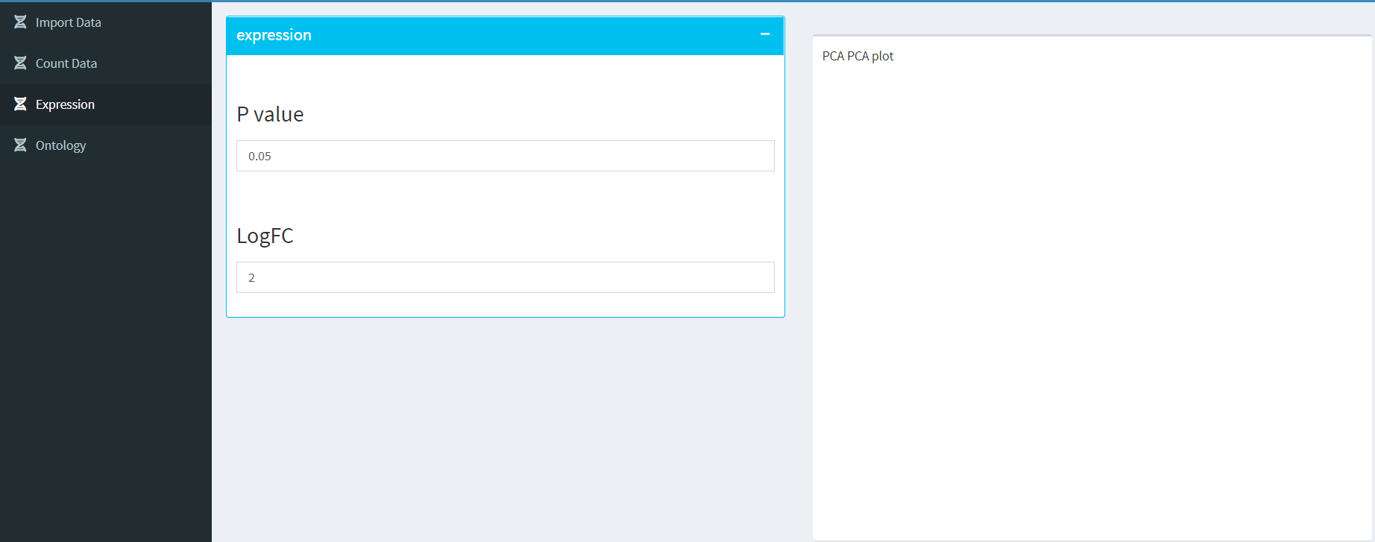
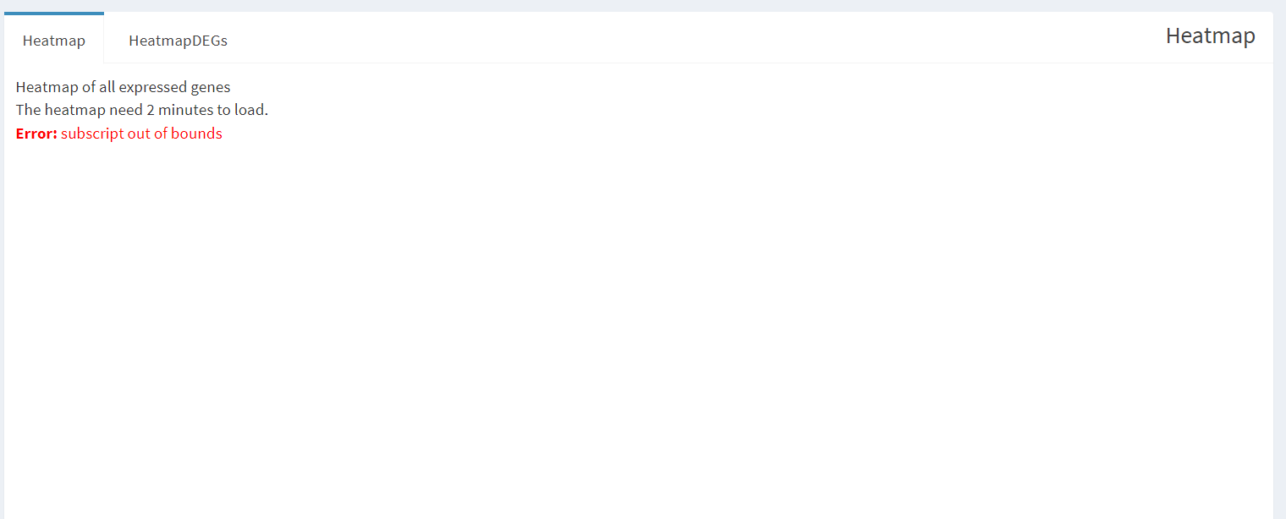
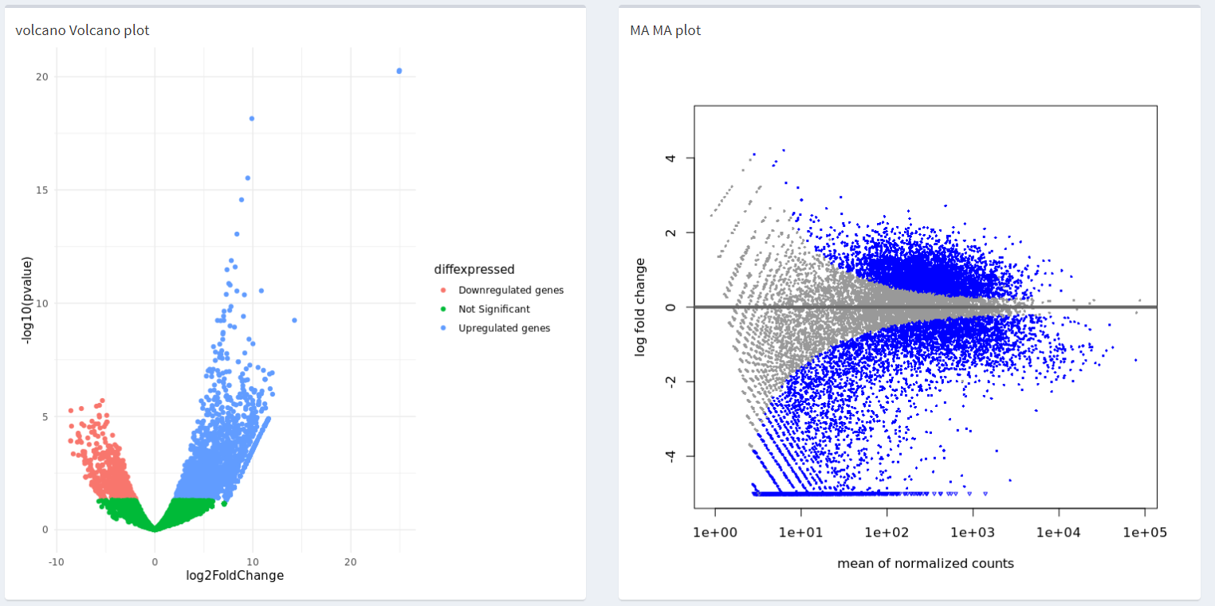
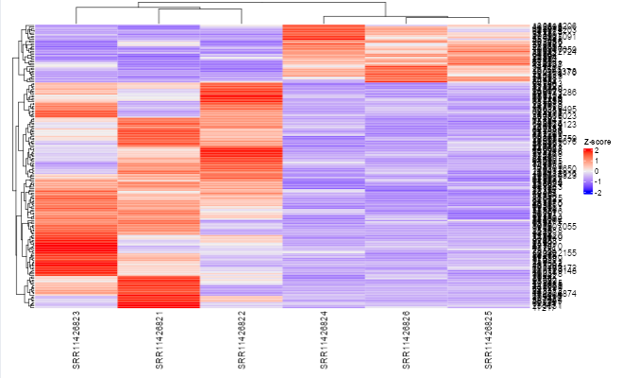
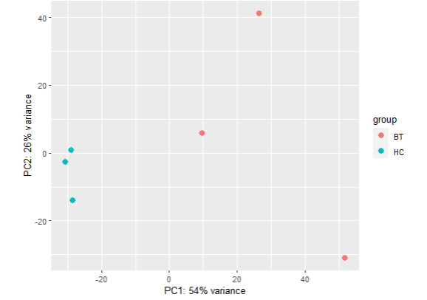

Slide 9
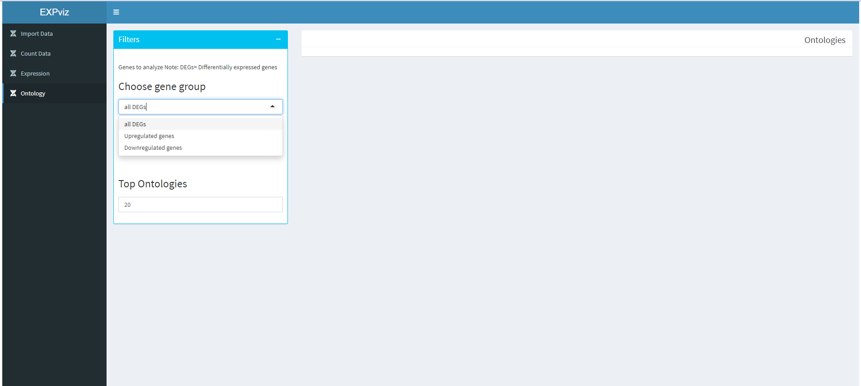
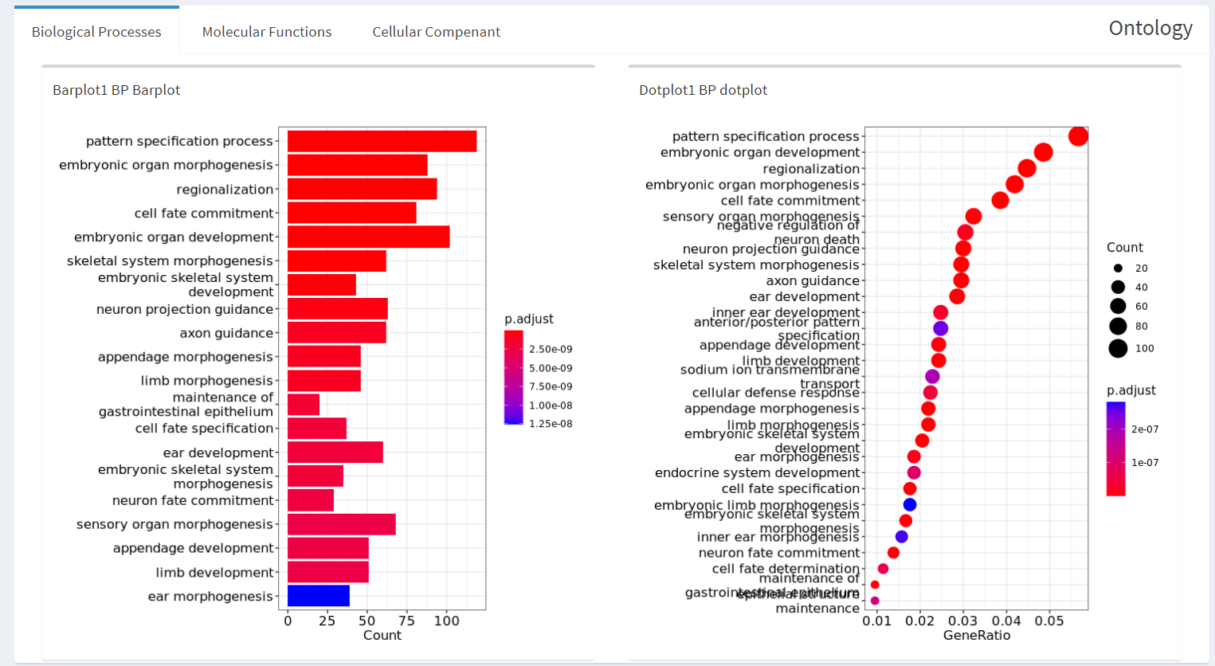

Slide 10
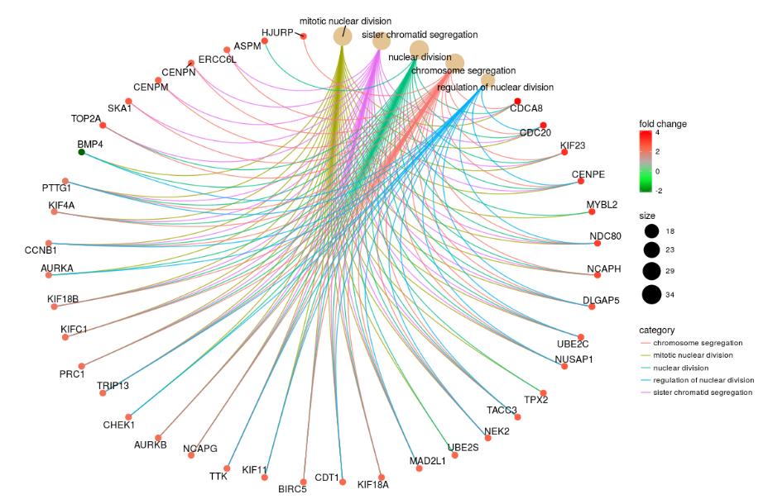
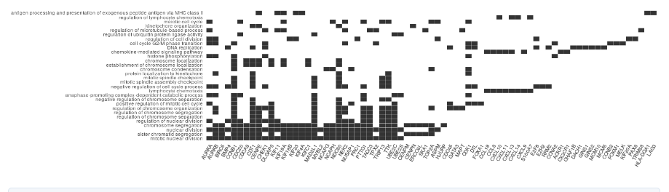
Gene-Concept Network
cnetplot
heatplot

Slide 11
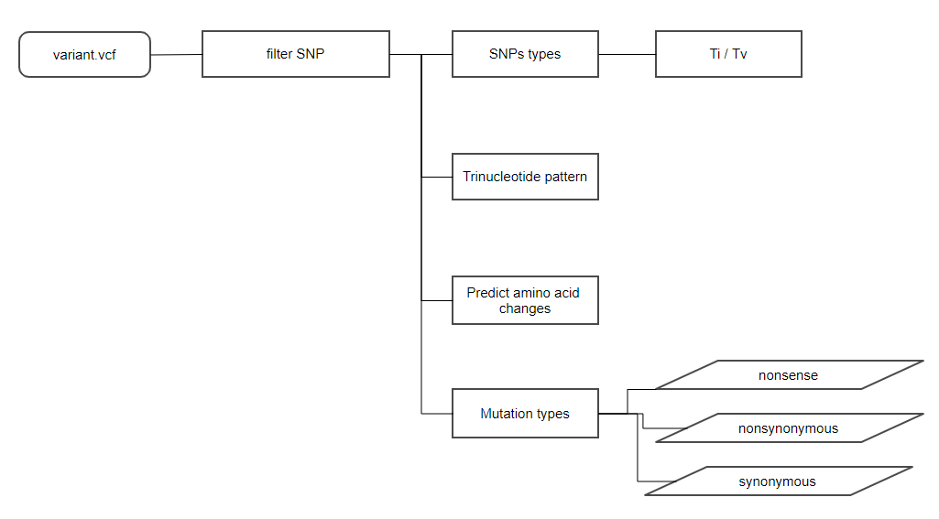
Workflow
SNPviz
The Transition (Ti): purine-to-purine, pyrimidine-to-pyrimidine,
Transveersion (Tv) : purine-to-pyrimidine, pyrimidine-to-purine,

Slide 12
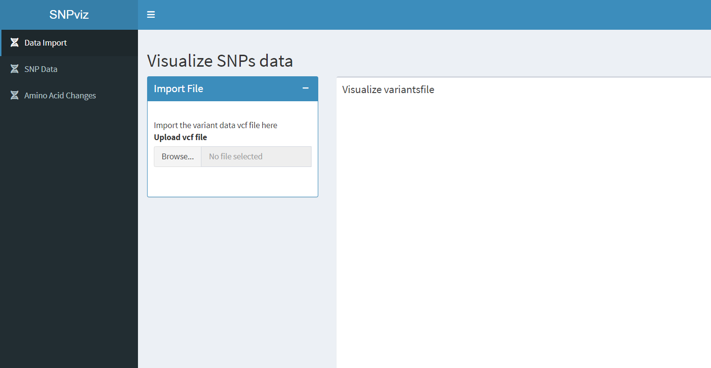

Slide 13
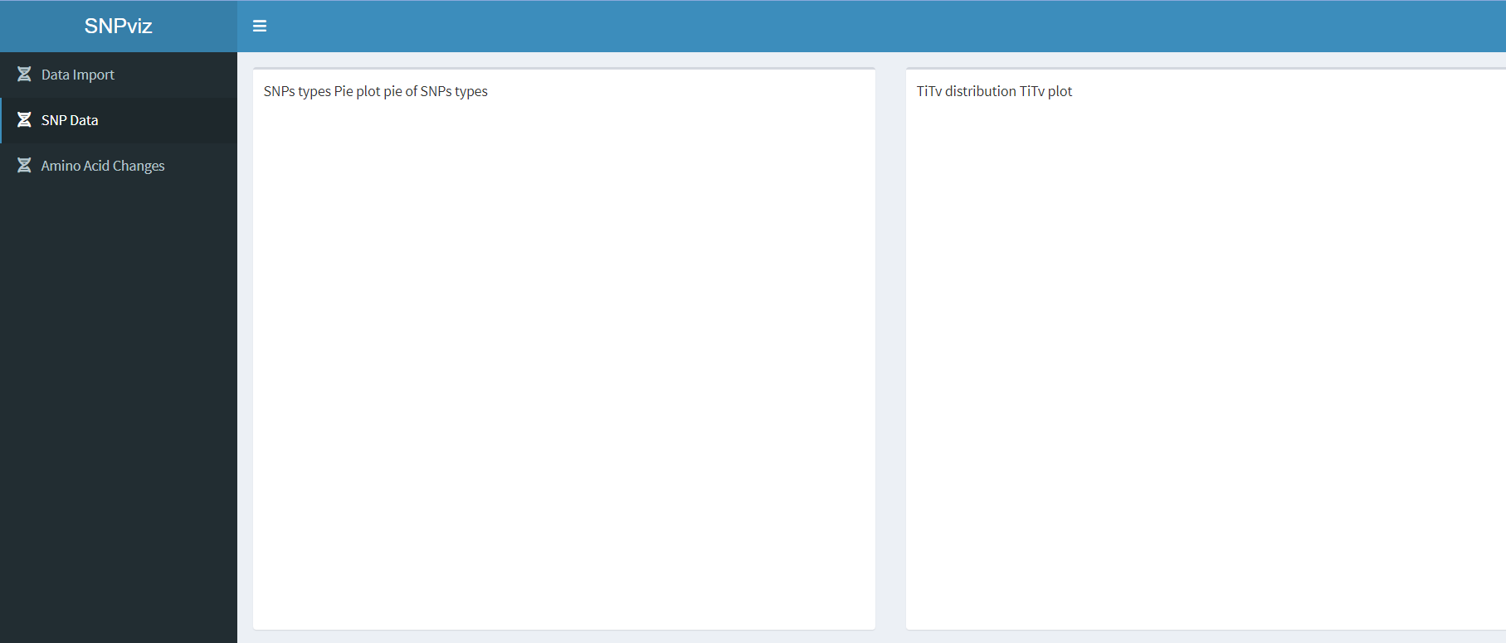
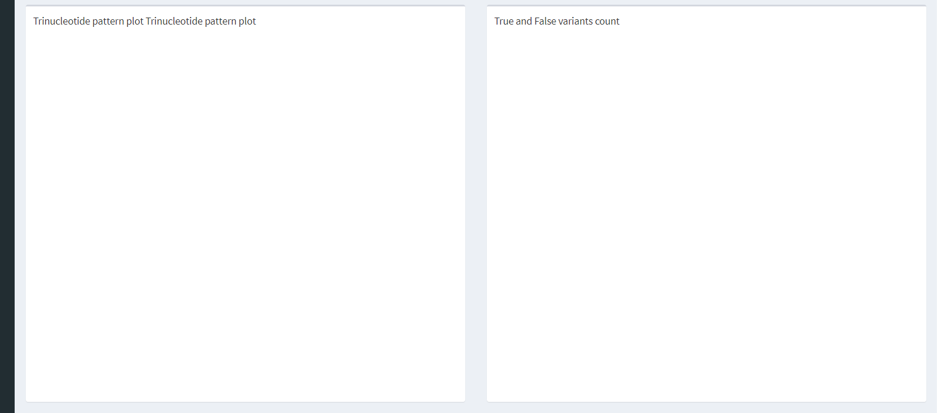
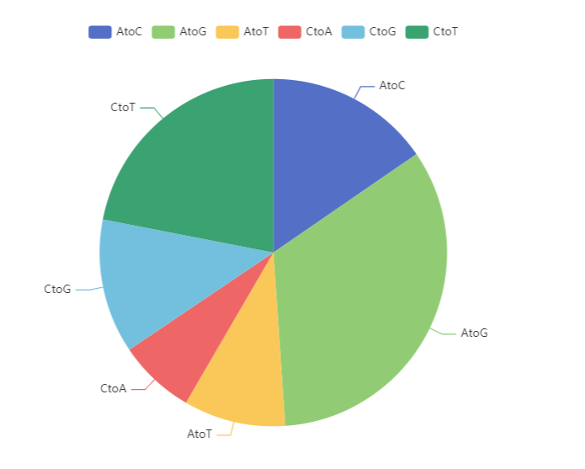
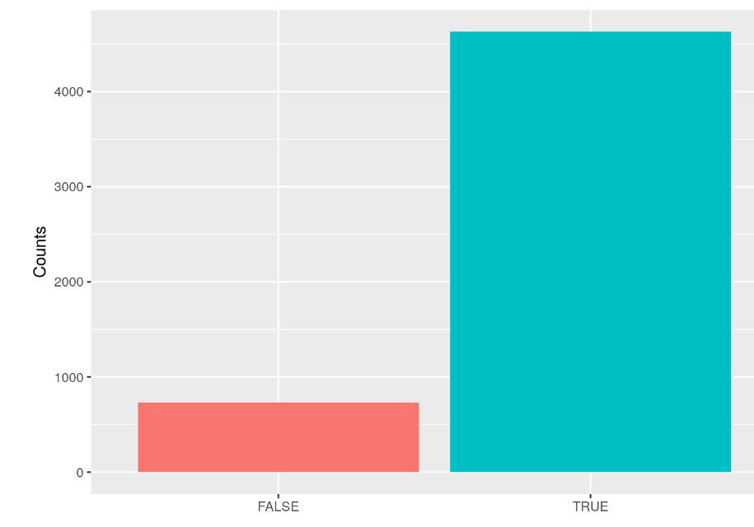
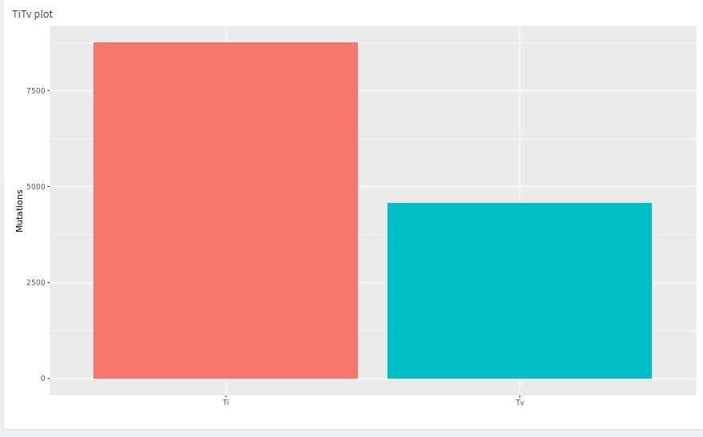
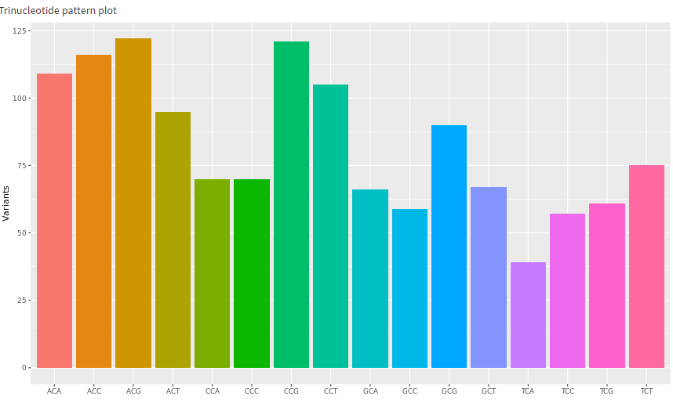

Slide 14
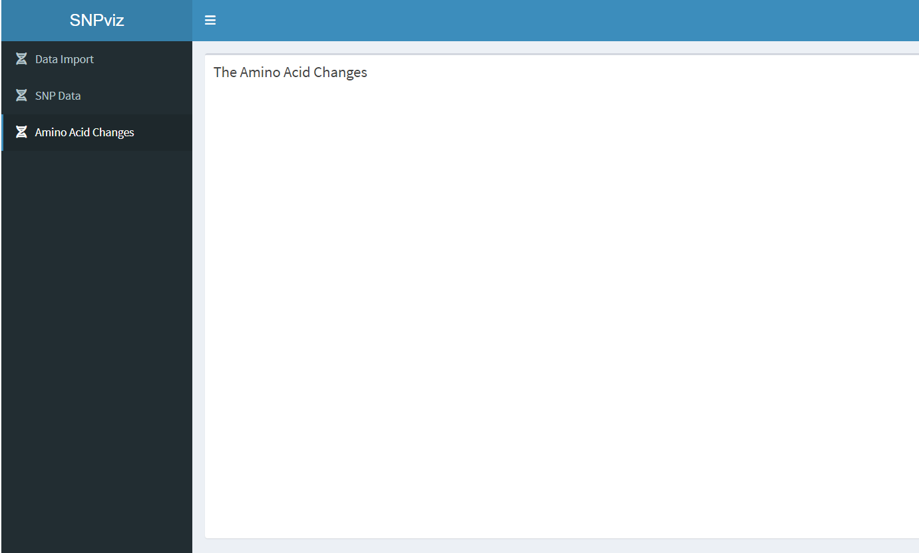
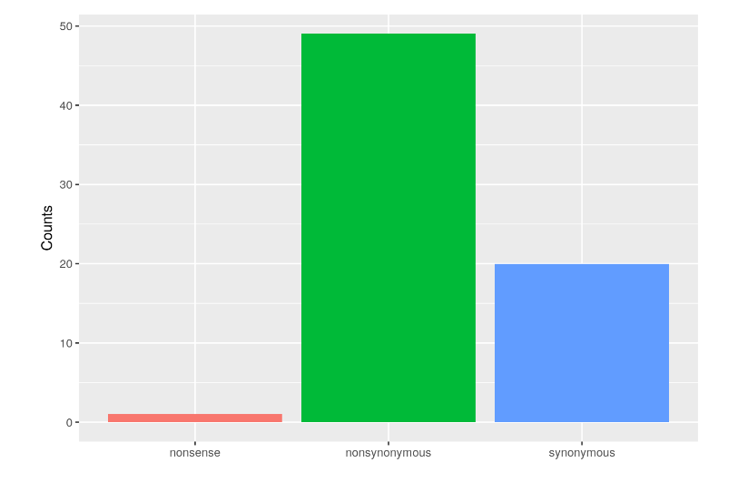

Slide 15
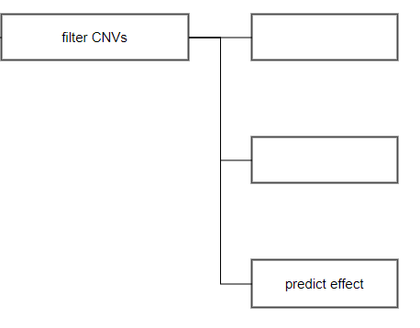
Workflow
CNVviz
cnv.csv
Identify recurrent
regions
Overlap analysis
Overlap permutation Test

Slide 16
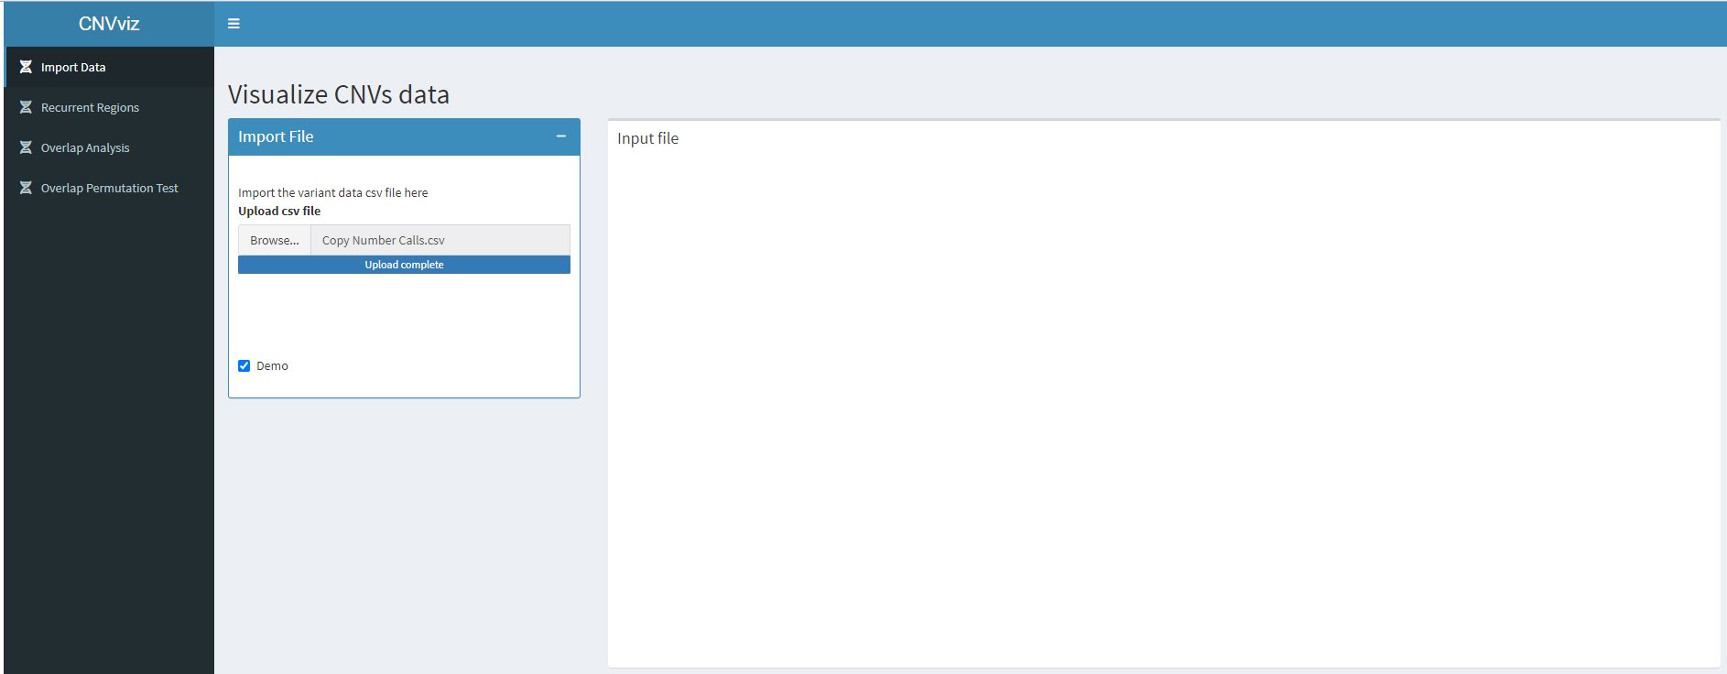
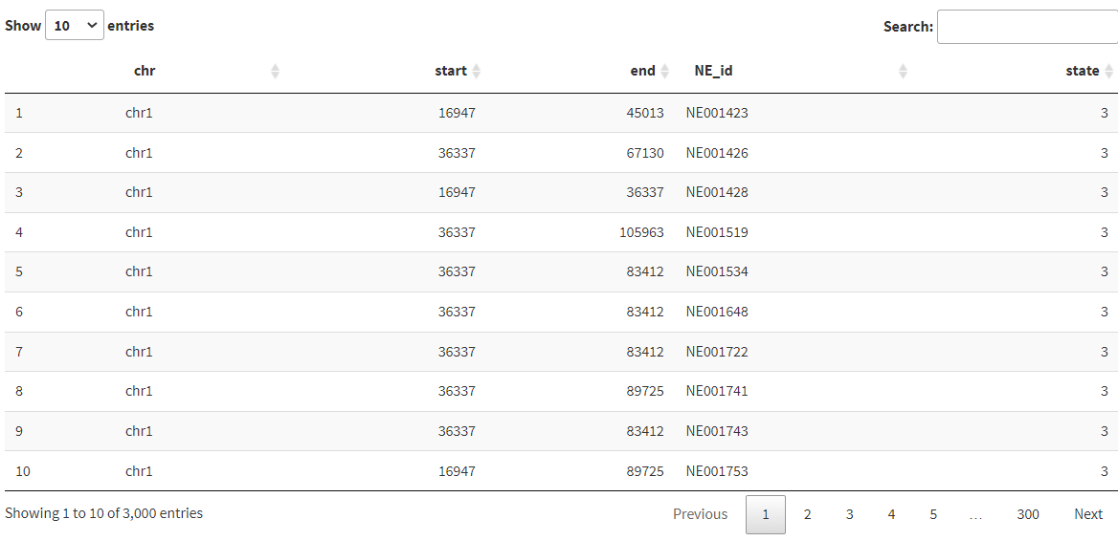
3. CNVviz

Slide 17
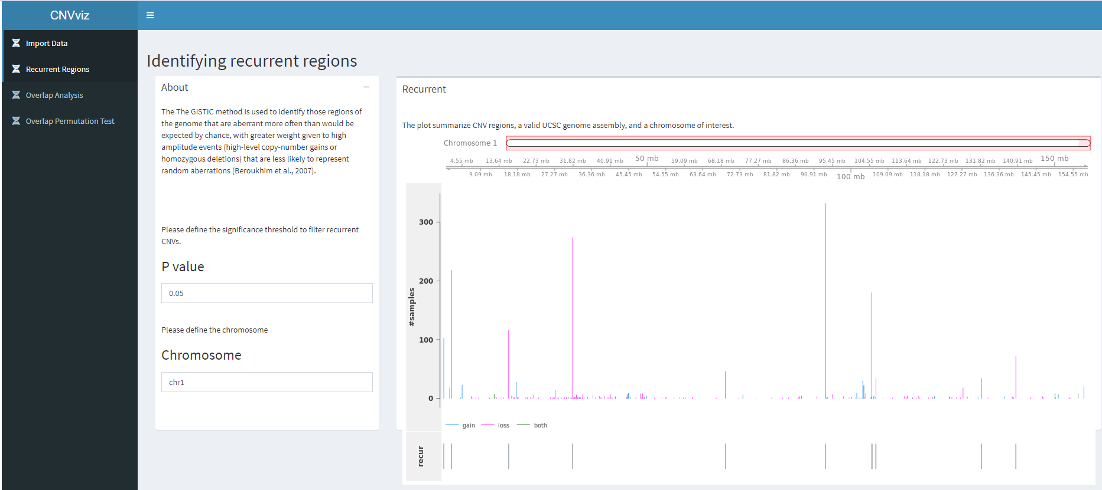

Slide 18
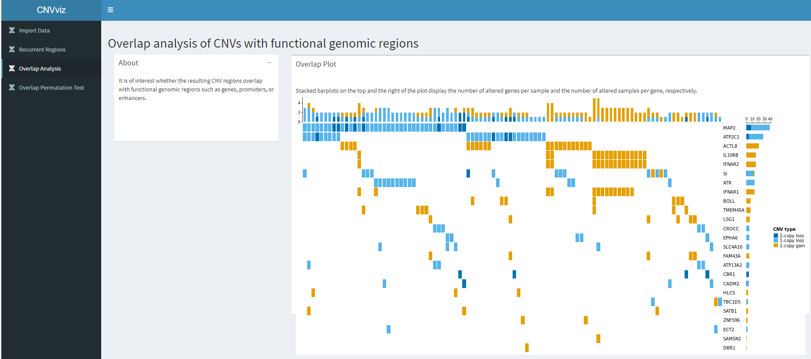
OncoPrint plot
= illustrate the original CNV calls on overlapping protein-coding genes

Slide 19
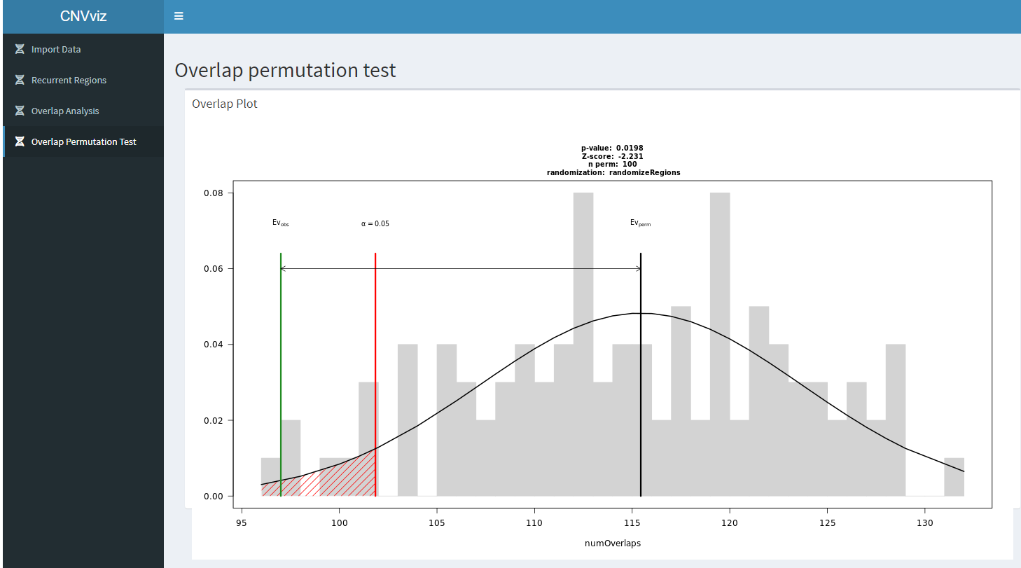

Slide 20
R package Functions
Function | Role | Input | Output
fastqProcession() | Proprecess fastq files | fastq | bam
gene_counting() | Count analysis | Bam | csv
geneExpression() | Identify DEGs | Bam | csv
call_snp() | SNPs calling | Bam | vcf
call_cnv() | CNVs calling | Bam | csv
call_indel() | Indels calling | Bam | vcf
Function | Role | Input | Output
EXPviz() | analyze and visualize the expression data | count csv file | interactive interface
SNPviz() | analyze and visualize the SNP data | vcf file | interactive interface
CNVviz() | analyze and visualize the CNV data | CNVs csv file | interactive interface

Slide 21
ExpVar vs Existing Tools

Slide 22
 | ExpVar | GATK4
Skill | Basic R programming knowledge (calling functions, setting variables etc.) | Unix command line syntax knowledge (installing software, running software + parameters etc.)
Computational Requirements | Linux OS Hardware Varies | Unix OS Hardware Varies
Inputs | FASTA, BSgenome (ref genome) FASTQ (unmapped seq) BAM (mapped seq) VCF, gVCF, CSV (variant calls) | FASTA (ref genome) uBAM (unmapped seq) SAM, BAM, CRAM (mapped seq) VCF, gVCF (variant calls)
Outputs | GMAP ref genome FASTQ (QC unmapped seq) SAM, BAM (mapped seq) VCF, gVCF, CSV (variant calls) CSV (differential expression) Visualisation Data | uBAM (unmapped seq) SAM, BAM, CRAM (mapped seq) VCF, gVCF, TSV (variant calls)
Dependencies/Add-ons | Installed automatically with package | Installed separately

Slide 23
 | EXPviz | easyGEO (eVitta) | easyGSEA (eVitta) | shinyGEO
Count data quality control | Yes | No | - | No
perform expression analysis | Yes (custom p value and logFC) | Yes (only custum p value) | - | Yes ( no custom p value or logFC)
survival analysis | No | No | - | Yes
Ontology analysis | Yes BP + CC +MF | No | only BP | No
KEGG enrichment analysis | Yes | No | Yes | No
enrichment analysis | Yes | No | Yes | No
Gene-Concept Network analysis | Yes | No | No | No

Slide 24
 | SNPviz | SnpHub
Analyzed data | all genome or a specific region | a specific region
Variant annotation | Yes | Yes
SNPs types identifications and count | Pie chart Barplot (Ti/Tv) | No
Trinucleotide motif analysis | Yes + barplot | No
Amino Acids changes analysis | Yes + distribution and count barplot | Yes + location graph
Phylogenetic | No | Yes - HapNet + PhyloTree

Slide 25
 | CNVviz | CNspector | ShinyCNV
visualized region | a specific region | a specific region | a specific region
gains and losses identification | Yes + table | Yes + graph | No
Recurrent CNV regions identification | Yes | yes | Yes
CNVs - genes overlapping | Yes | No | No
overlap mutated test | Yes | No | No
clinical assessment of CNVs | No | Yes | No
Haplotypes | No | No | No

Slide 26
Conclusion
ExpVar provides a unique combination of analysis and visualization features for biologists with limited programming skills.
With only the need of FASTQ files, the user can perform multiple analyses and visualize biological data without the need for any third-party program.
The ExpVar package is publicly available in the project GitHub repository:
github.com/omicscodeathon/ExpVar

Slide 27
Acknowledgements
The authors thank
The African Society for Bioinformatics and Computational Biology (ASBCB).
The National Institutes of Health (NIH)
The Office of Data Science Strategy (ODSS)
and the National Center for Biotechnology Information (NCBI)
for their immense support before and during the codeathon.

